Slide 1


SMART INDIA HACKATHON 2025
Problem Statement ID –SIH25010
Problem Statement Title - Smart Crop Advisory System for Small and Marginal Farmers
Theme- Agriculture, FoodTech & Rural Development
PS Category-Software
Team ID-79
Team Name (Registered on portal)-StegoSquad

Slide 2
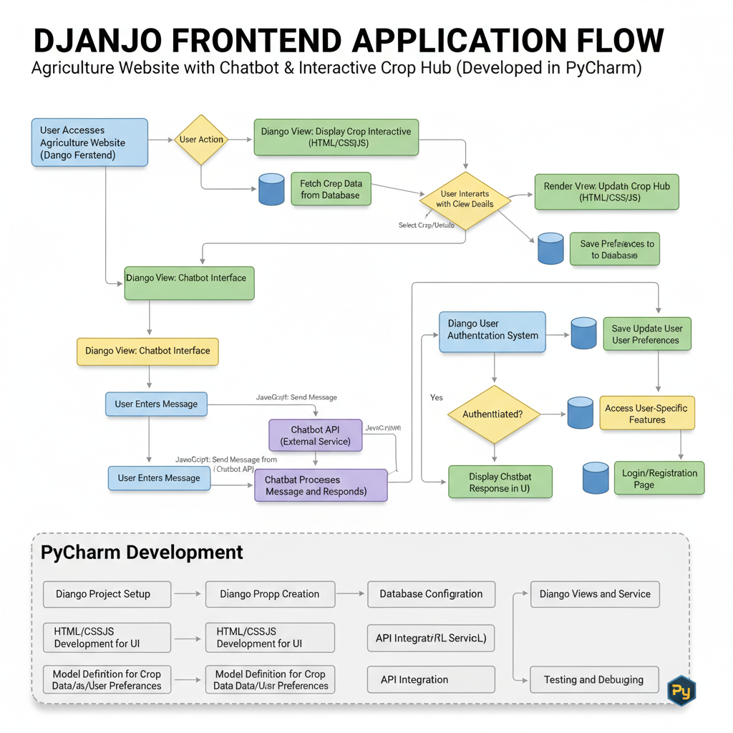
SMART CROP ADVISORY SYSTEM FOR SMALL AND MARGINAL FARMERS
Stego
Squad
Real-time monitoring of soil, weather, and crop conditions
Integration of weather forecasts for early warnings
Crop selection based on soil, climate, and market demand
Fertilizer type and dosage recommendations
Smart irrigation schedule to save water
Pest and disease alerts with preventive measures
Mobile and web dashboard for farmers
Supports multiple languages for accessibility
Promotes sustainable and organic farming practices
Reduces input costs (water, fertilizer, seeds)
Increases crop yield and profitability

Slide 3
TECHNICAL APPROACH
StegoSquad
🔄 Methodology
Data Collection :
Sensors capture soil moisture, pH, temperature.
Weather API provides forecast data.
Market data sources give demand & price trends.
AI Model Processing
Collected data is sent to a cloud-based AI system.
AI processes soil + weather + market information.
Generates recommendations for:
Crop selection
Fertilizer usage
Irrigation scheduling
Pest & disease alerts
Decision Support Output
Recommendations delivered through Mobile/Web App.
Farmers receive easy-to-understand instructions.
🛠️ Technologies Used :
Artificial Intelligence / Machine Learning (AI/ML)
Crop recommendation models analyze soil, climate & market data.
Predicts best suitable crops for maximum yield & profit.
ML improves accuracy with more farmer data (feedback).
IoT Sensors :
Soil Moisture Sensors → Check when to irrigate.
pH Sensors → Measure soil acidity/alkalinity for crop suitability.
Temperature & Humidity Sensors → Track environmental conditions affecting crops.
Mobile / Web Application :
Farmer-friendly interface in local language.
Provides real-time alerts, graphs, and recommendations.
Can integrate with government databases for subsidies & schemes.

Slide 4
FEASIBILITY AND VIABILITY
StegoSquad
⚠️ Potential Challenges
Internet Connectivity in Rural Areas
Many farms are located in remote villages where 4G/5G or broadband is unreliable.
IoT sensors and AI apps need stable connectivity to send data to the cloud or receive insights.
Without internet, real-time analysis becomes difficult.
Farmers’ Digital Literacy
Majority of small and marginal farmers may not be familiar with using smartphones, apps, or digital dashboards.
Language barriers and lack of technical awareness further limit adoption.
💡 Solutions
Training Programs & Farmer Awareness Camps
Organize on-field demonstrations showing how sensors and AI tools can increase yield and reduce costs.
Use local language interfaces in apps to ensure farmers can understand results easily.
Provide basic smartphone training so farmers feel confident in using technology.
Low-Cost IoT Sensors
Affordable soil moisture, temperature, and humidity sensors are now available.
These devices can be deployed in fields to continuously monitor crop health, soil condition, and weather.
Because they are inexpensive, even small-scale farmers can adopt them without huge financial burden.
Open-Source AI Models
Pre-trained AI models for pest detection, disease classification, and yield prediction are freely available.
Farmers or local startups can customize these models for regional crops without investing in expensive proprietary software.
Example: Models built with TensorFlow, PyTorch, or OpenCV can run on low-power devices like Raspberry Pi.

Slide 5
IMPACT AND BENEFITS
StegoSquad
✅ Benefits
Economic 💰
Higher crop yield → more marketable surplus.
Better price discovery (market linkage).
Reduced input costs (fertilizer, water, pesticides).
2. Social 👨‍👩‍👧‍👦
Farmers make data-driven decisions.
Builds confidence & awareness in rural communities.
Knowledge sharing among farmer groups.
3. Environmental 🌍
Sustainable farming → optimized water & fertilizer use.
Reduced chemical usage → healthier soil & crops.
Encourages climate-smart agriculture.
🌟 Impact :
Empowers Small & Marginal Farmers :
Farmers get real-time smart advisory in simple language.
Reduces dependence on middlemen & unreliable info.
Reduces Crop Loss
Early warning for pests, diseases & irrigation needs.
Farmers can take timely action → save crops.
Increases Productivity
Right crop selection + scientific farming practices.
Improves yield per acre significantly.

Slide 6
RESEARCH AND REFERENCES
StegoSquad
Government Reports on Indian Agriculture Productivity
Reports by Ministry of Agriculture & Farmers’ Welfare highlight:
Yield gaps between traditional vs. technology-driven farming.
Low productivity due to improper irrigation, fertilizer misuse & pest attacks.
Need for digital & IoT-based solutions for sustainable agriculture.
🌍 FAO Smart Farming Initiatives
The Food and Agriculture Organization (FAO) promotes Smart Farming practices worldwide.
Focus areas:
IoT for precision irrigation & fertilizer application.
AI for early disease detection.
ICT-based platforms for farmer training & market access.
Shows that global adoption of AI + IoT improves food security.
📑 Research Papers on AI in Agriculture
Studies in IEEE, Springer, and Elsevier journals:
AI crop recommendation models increase yield by 10–15%.
Computer vision models detect crop diseases with >90% accuracy.
IoT soil monitoring reduces irrigation water use by 20–30%.
🇮🇳 Indian Digital Agriculture Examples
Kisan Call Center (KCC)
Farmers can call toll-free numbers for advice in local languages.
Connects farmers directly to agri-experts.
e-Choupal (ITC initiative)
Village-level digital kiosks provide market prices & agri-info.
Helps farmers sell directly → better profits.

